Slide 1
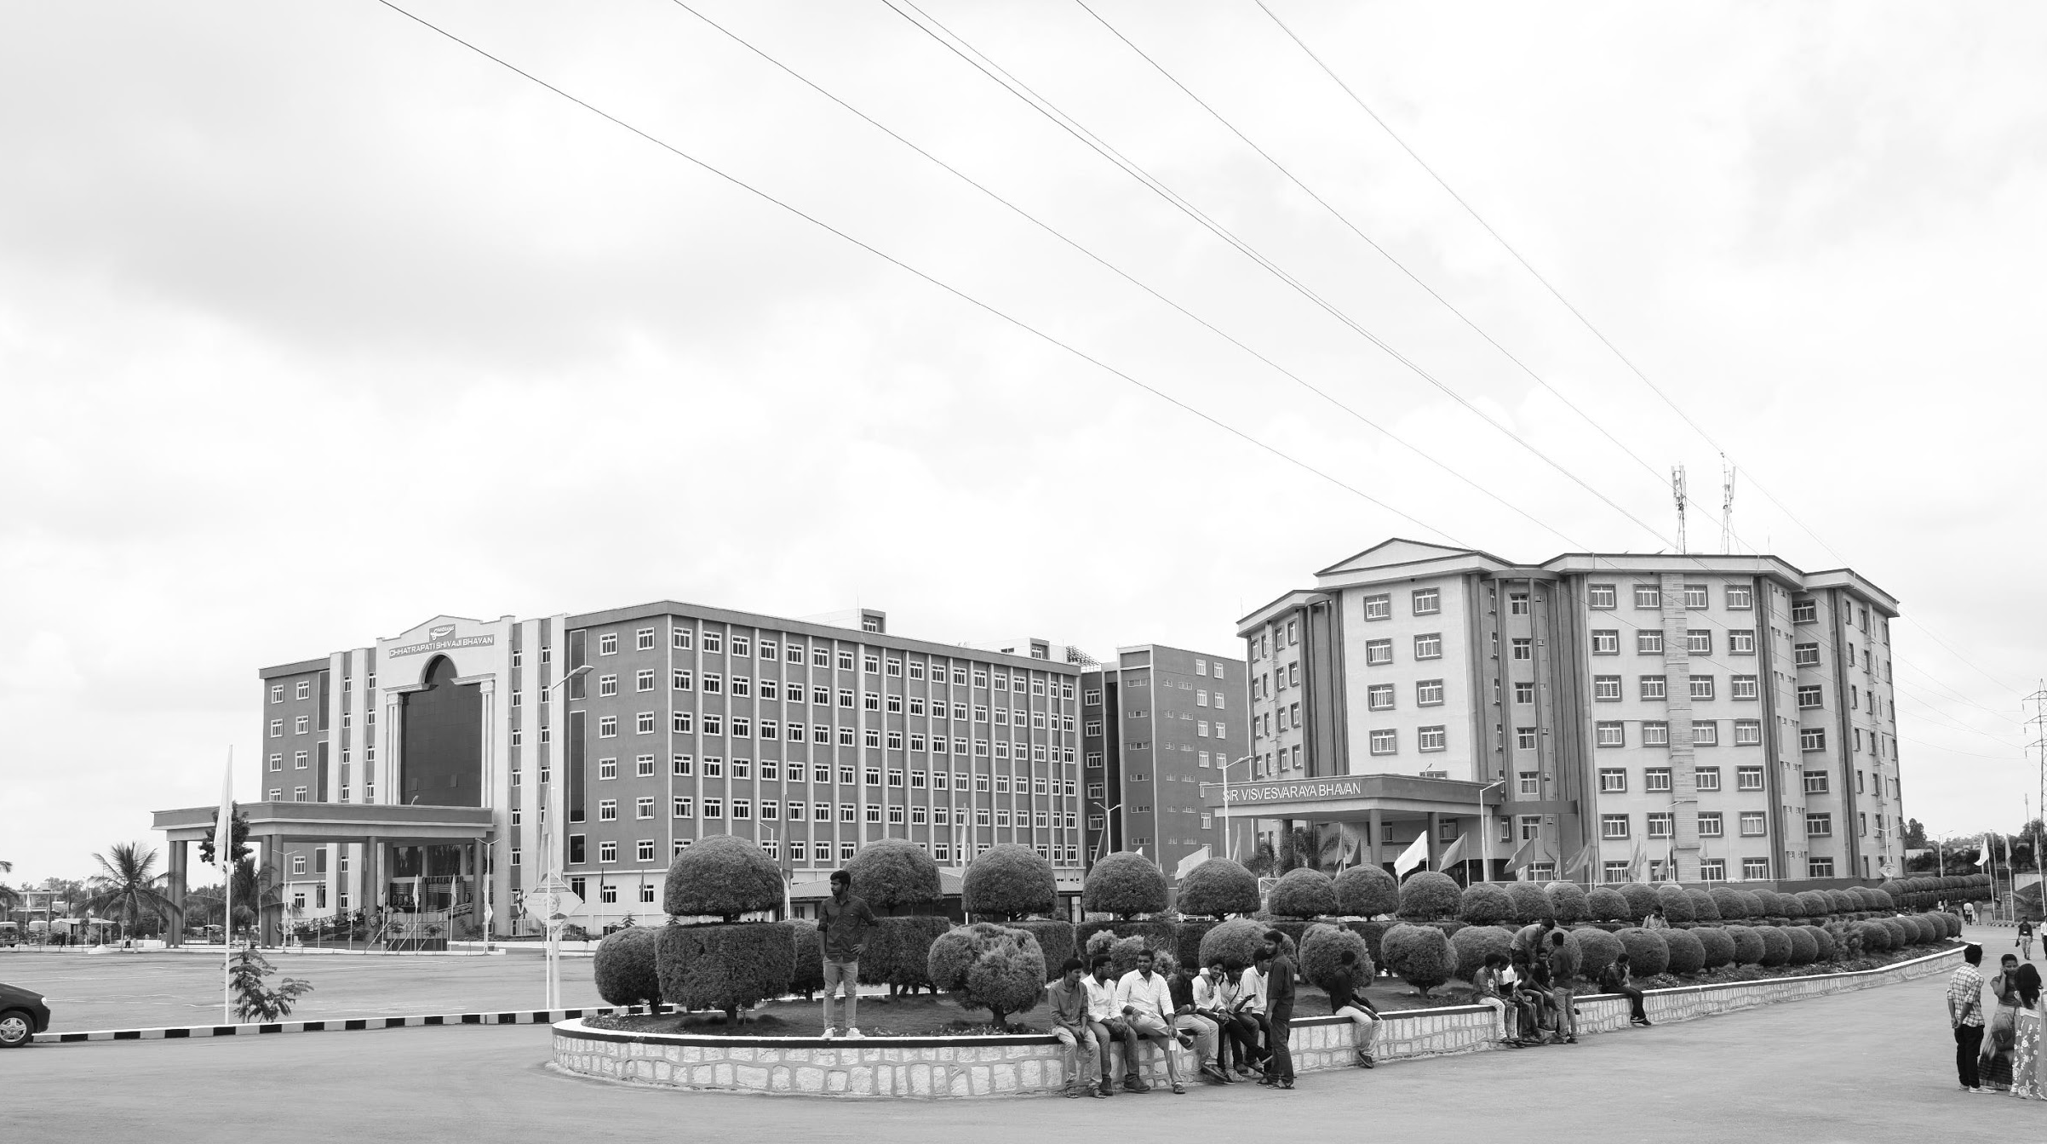

Review-I
Approximate Computing For Image/Signal Processing
AY 2025-26
Capstone Project – Introduction (PROJ2999)
GITAM (Deemed-to-be) University
Department of Electrical Electronics and Communication Engineering
Project Team:
Aishwarya KV
Akhila
Gadiputi Vinya Vardhan
Project Mentor:
Shatadal Chatterjee
Project In-charge:
Shatadal Chatterjee
www.gitam.edu

Slide 2
Objective and Goals
Objective
To design and implement approximate computing techniques for image processing applications, focusing on reducing power consumption and hardware complexity. The work targets error-tolerant tasks like filtering and compression, ensuring visually acceptable quality using metrics such as PSNR and SSIM. The design will be optimized for low-power platforms like FPGAs or ASICs, enabling efficient real-time processing in resource-constrained environments.
Goals
Main Goals
Develop approximate arithmetic-based architectures suitable for image processing.
Reduce power consumption and hardware complexity while maintaining acceptable image quality.
Implement and test the design on a reconfigurable hardware platform (e.g., FPGA).
Additional Goals
Compare the proposed approximate design with conventional exact computing methods.
Optimize the design for different image processing operations (e.g., filtering, enhancement, compression).
Explore scalability of the architecture for higher-resolution images.
Provide a framework that can be extended to other domains such as video or real-time signal processing.

Slide 3
Project Plan (Clearly mention milestone for objectives under each reviews)
Week | Activities | Milestone
Week 1 | Finalize selection of approximate adders and multipliers (e.g., LOA, AMA, etc.) | Component Selection Complete
Week 2 | Design and simulate adders/multipliers using Verilog/VHDL or MATLAB | Functional Design Simulated
Week 3 | Synthesize and test hardware on FPGA/EDA tools (analyze area, delay, power) | Synthesis and Evaluation Completed
Week 4 | Compare approximate vs. accurate units; document trade-offs | Report of Comparison and Analysis Done

Slide 4
Literature Survey
Key Publications
Design of a Hardware-Efficient Approximate 4-2 Compressor for Multiplications in Image Processing
Authors: Sungyoun Hwang, Kon-Woo Kwon, and Yongtae Kim
Journal: IEEE EMBEDDED SYSTEMS LETTERS
Insights: This paper presents a hardware-efficient approximate compressor that is optimized for image processing by accurately handling the most frequent input patterns to reduce errors and improve image quality.
References: A. Sadeghi, R. Ghasemi, H. Ghasemian, and N. Shiri, “High efficient GDI-CNTFET-based approximate full adder for next generation of computer architectures,” IEEE Embed. Syst. Lett., vol. 15, no. 1, pp. 33–36, Mar. 2023.
M. S. Ansari, H. Jiang, B. F. Cockburn, and J. Han, “Low-power approximate multipliers using encoded partial products and approximate compressors,” IEEE J. Emerg. Sel. Topics Circuits Syst., vol. 8, no. 3, pp. 404–416, Sep. 2018.
2. High-Precision, Low-Delay Approximate Multiplier Using 4-2 Compressor and Error Recovery
Authors: Jongmin Jeon, Youngmin Kim
Journal: 2025 International Technical Conference on Circuits/Systems, Computers, and Communications (ITC-CSCC)
Insights : his paper proposes a new approximate multiplier architecture that enhances accuracy and hardware performance by integrating an error recovery module with a conventional approximate 4-2 compressor.
References:D. Esposito, A. G. M. Strollo, et al., “Approximate Multipliers Based on New Approximate Compressors”, in IEEE Transactions on
Circuits and Systems I: Regular Papers, vol. 65, no. 12, December 2018.
U. A Kumar, P. Bikki, et al., “Power Efficient Approximate Multiplier Architectures for Error Resilient Applications”, in 2022 IEEE 19th India Council International Conference (INDICON), February 2023.
3. On the Design of Iterative Approximate Floating-Point Multipliers
Authors: Ahmad Towhidy, Reza Omidi, and Karim Mohammadi
Journal: IEEE TRANSACTIONS ON COMPUTERS
Insights : This research proposes novel iterative (IPB) and non-iterative (PB) approximate floating-point multipliers using a "pseudo-Booth encoding" scheme. The accuracy of these multipliers can be tuned by adjusting parameters like iteration count, encoder radix, and truncation, allowing for a flexible trade-off between performance and precision. The iterative version can achieve extremely high accuracy, making it almost as precise as an exact multiplier for error-resilient applications.

Slide 5
References:V. K. Chippa, S. T. Chakradhar, K. Roy, and A. Raghunathan,“Analysis and characterization of inherent application resilience
for approximate computing,” in Proc. 50th Annu. Des. Automat. Conf., 2013, pp. 1–9, doi: 10.1145/2463209.2488873.
H. Jiang, F. J. H. Santiago, H. Mo, L. Liu, and J. Han, “Approximate arithmetic circuits: A survey, characterization, and recent applications,” Proc. IEEE, vol. 108, no. 12, pp. 2108–2135,Dec. 2020.
4: Design of Power and Area Efficient Approximate Multipliers
Authors: Suganthi Venkatachalam and Seok-Bum Ko
Journal: IEEE TRANSACTIONS ON VERY LARGE SCALE INTEGRATION (VLSI) SYSTEMS
Insights : This paper designs efficient approximate multipliers by altering partial products into signals with different probabilities and using simpler logic for the low-probability terms, which saves significant power and area.
References:V. Gupta, D. Mohapatra, A. Raghunathan, and K. Roy, “Low-power digital signal processing using approximate adders,” IEEE Trans. Comput.-Aided Design Integr. Circuits Syst., vol. 32, no. 1, pp. 124–137,Jan. 2013.
H. R. Mahdiani, A. Ahmadi, S. M. Fakhraie, and C. Lucas, “Bio-inspired imprecise computational blocks for efficient VLSI implementation of soft-computing applications,” IEEE Trans. Circuits Syst. I, Reg. Papers,vol. 57, no. 4, pp. 850–862, Apr. 2010.
Key Resources
Whitepapers
Approximate Computing: Principles and Applications (overview papers, surveys)
Design Guidelines for Approximate Arithmetic Units
Libraries
EvoApprox8b → Library of ~430 adders & ~471 multipliers (Verilog)
AxBench → Benchmark suite for approximate computing
Application Notes
Case studies in image processing (image blending, filtering, encoding) from Masadeh et al., Mrazek et al., Kumar et al.
Error metrics & evaluation methods (PSNR, SSIM, MED, NMED)
Datasheets / Models
Verilog & FPGA implementations in supplementary files of research papers
Gate-level synthesis reports (area, power, delay) from FPGA/ASIC designs
Others (Open Source & Tools)
GitHub repos of EvoApprox, approximate adders/multipliers (Verilog/VHDL)
Open datasets for error analysis (AxBench, image/video datasets)
ArXiv preprints with code links (new 2025 designs)

Slide 6
Existing Implementations – Products| Opensource| GitHub etc
Open-Source Libraries / Frameworks
lpACLib – Low-power approximate adders/multipliers.
iACT – Intel toolkit for software-hardware co-design.
Approxilyzer – Instruction-level approximation analysis.
MAxPy – Python-based framework for VLSI approximate computing.
AxOSyn – Synthesizes approximate arithmetic operators.
ALWANN – Layer-wise approximation for DNN accelerators.
GitHub Projects
approximate-computing – Collection of DNN/hardware approximation projects.
phoeniX – RISC-V platform for approximate computing cores.
Products / Platforms
HEAAN – Homomorphic encryption library with approximate arithmetic.
Qalculate! – Open-source calculator with approximate computation support.

Slide 7
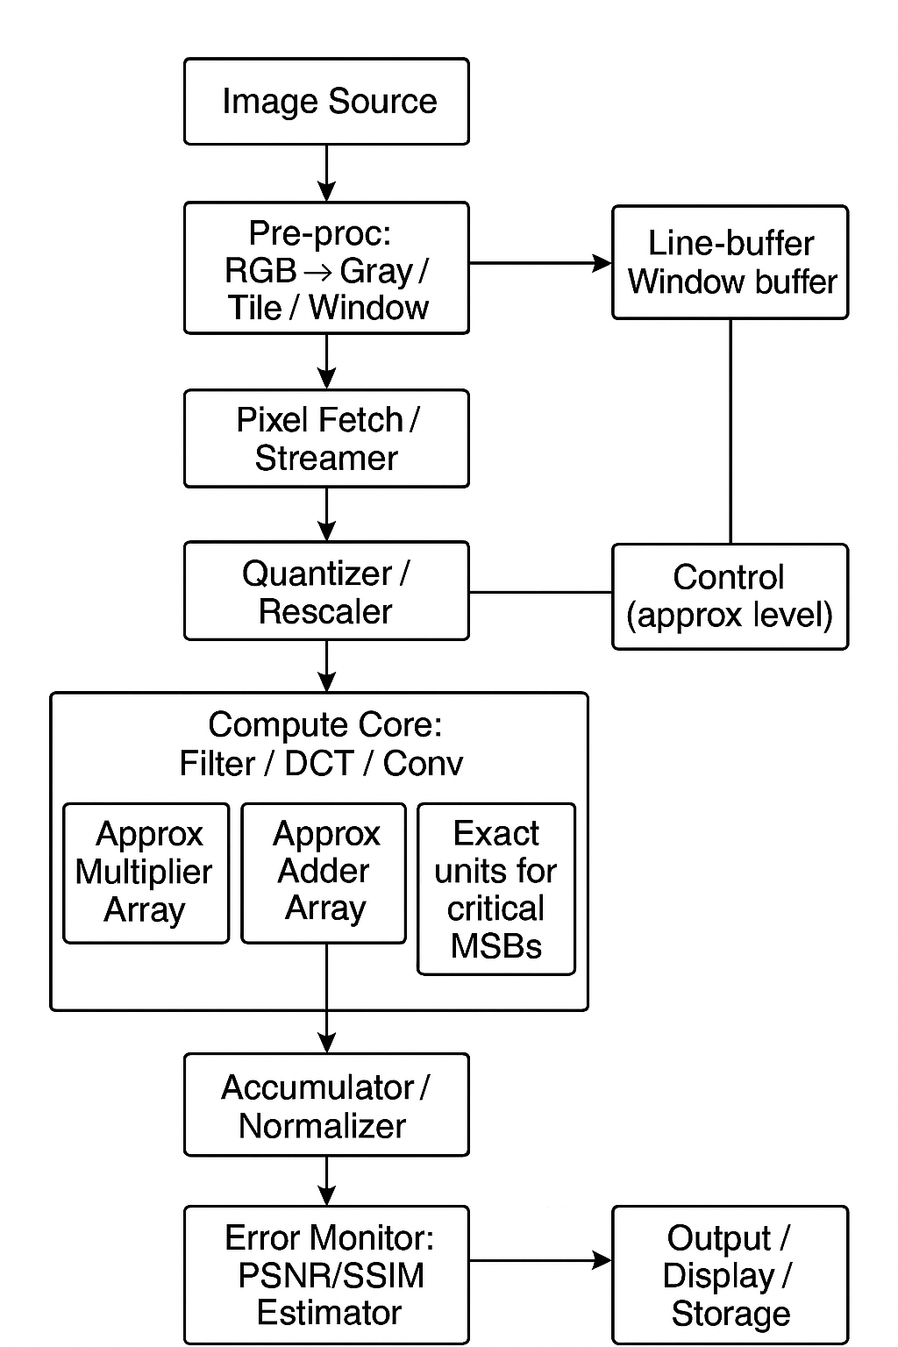
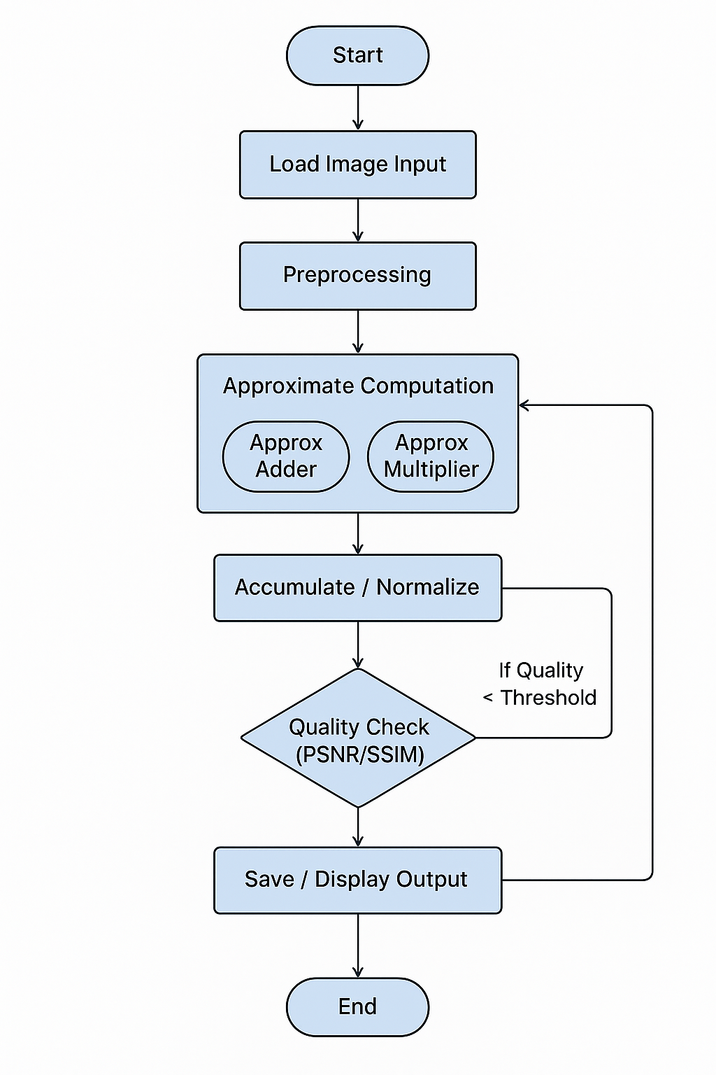
Architecture
Structural Diagram
Behaviour Diagram

Slide 8
Use Cases & Testing
Use Cases
AI & ML – Faster, energy-efficient neural network inference.
Multimedia – Image, video, audio processing with minor quality loss.
Embedded/IoT – Low-power sensor and microcontroller operations.
Scientific Computing – Approximate simulations and iterative methods.
Data Analytics – Faster aggregation and streaming data processing.
Social Impact:
This project's social impact is in advancing energy efficiency and enabling a more sustainable future by reducing power consumption and hardware size. This research can enable the next generation of smart devices and IoT by allowing for more powerful and longer-lasting systems that can perform complex tasks.
Testing / Evaluation
Error Metrics – MAE, MSE, error rate.
Quality Metrics – PSNR, SSIM for multimedia.
Performance – Energy, latency, throughput comparison.
Reliability – Stress tests and extreme input scenarios.
Benchmarking – Real workloads like CNNs, video encoding, sensor data.

Slide 9
Conclusion & Future Work
Summary and Conclusion
Approximate adders and multiplexers are key enablers of energy-efficient and high-speed digital designs. By allowing controlled inaccuracies in computation, they significantly reduce power consumption, hardware area, and processing delay without severely impacting overall system performance. These components are especially valuable in resource-constrained environments such as embedded systems, edge computing devices, and AI accelerators.
The adoption of approximate circuits also promotes scalable design, enabling larger systems to operate more efficiently while maintaining acceptable output quality. Furthermore, these techniques provide flexibility in balancing performance, power, and accuracy, allowing designers to optimize circuits based on specific application requirements.
Future Work
Dynamic Approximation: Adjusting the level of approximation in real-time based on workload or error tolerance.
Explore 3×3 image convolution using approximate adders and multiplexers for further optimized performance and lower power consumption.
Energy-Aware Hardware Design – Design low-power FPGA/ASIC implementations for embedded image processing systems.
Error-Resilient Techniques – Develop methods to monitor and correct errors while maintaining efficiency in visual output.

Slide 10
THANK YOU
Have a Great Day !

